Slide 1
3D Graphics and Animation

Slide 2
Physics Engine
Provides an approximate simulation of certain physical systems, such as
rigid body dynamics (including collision detection),
soft body dynamics, and fluid dynamics,
Use in
computer graphics,
video games (real time simulation)
film (CGI).

Slide 3
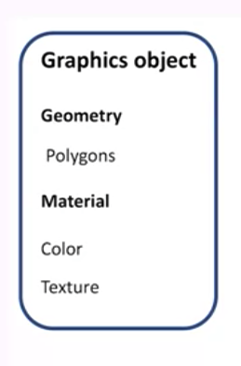
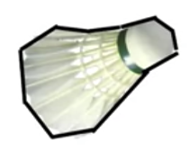
Graphics Object

Slide 4
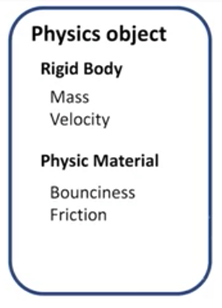
Physics Object
Consists of Rigid object and Physic Material
Rigid Body
doesn't move in itself,
doesn't stretch,
doesn't bend.

Slide 5
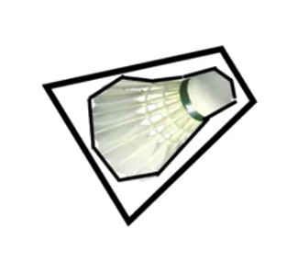
Collision detection
Collision Geometry
Add to Rigid body for collision detection between two object

Slide 6
Collision detection
Graphics Object
Need details graphical geometry, so it looks great.
Physics Object
Physics geometry to be a lot simpler so the physics engine calculation can be fast.
Human can't really tell the difference between how a box bounces and how something that is a box with a little bit of extra detail bounces.
It doesn't make much difference to human perception.

Slide 7
Collision detection
Physics Object
If object looks a lot like a box, make it a box.
If object looks a lot like a bowl, make it a sphere, sphere collisions are actually very fast to calculate.

